Slide 1
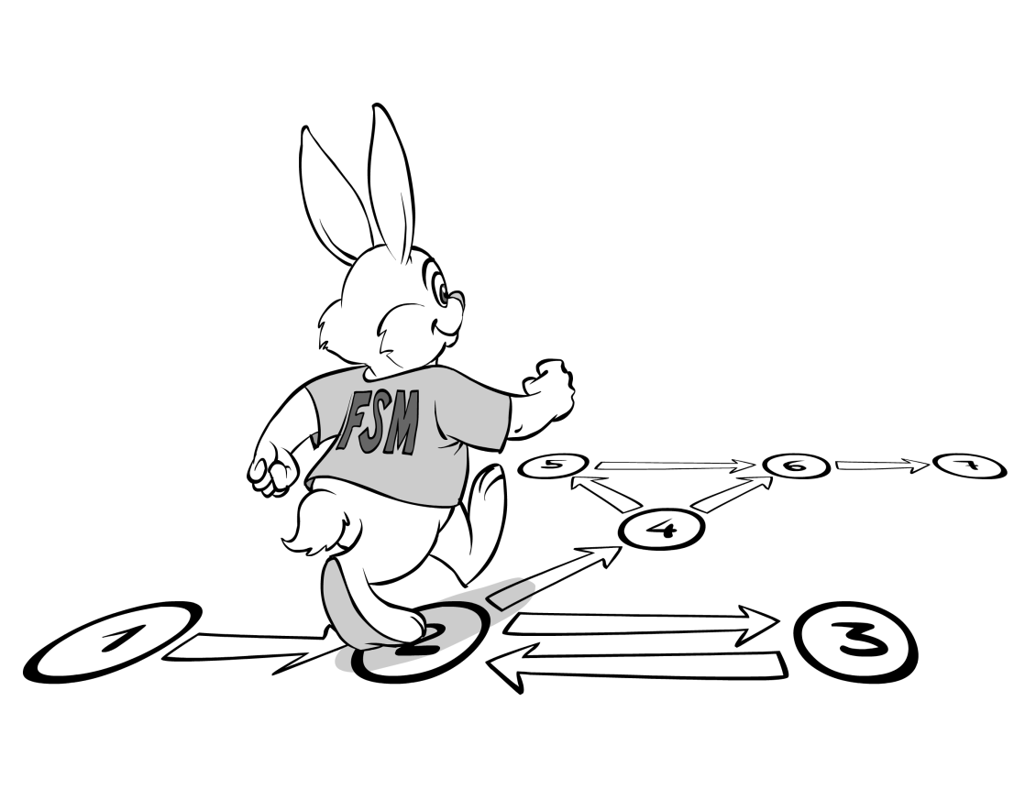
Finite State Machine
(Automaton)
2nd Semester 2017-2018
Dr. Abdulhussein M. Abdullah
Lec #2

Slide 2
An automaton is an abstract model of a compute

Slide 3
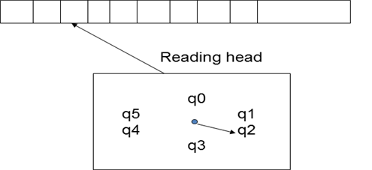
Automaton
An input string is placed on the tape (left-justified).
Input Tape
Start State
Finite Control

Slide 4
How does a Automaton work?
An input string is placed on the tape (left-justified).
Automata begins in the start state.
Head placed on leftmost cell.

Slide 5
Automata goes into a loop until the entire string is read.
In each step, Automata consults a transition table and changes state based on (s, σ) where
s - current state
σ - symbol scanned by head
After reading input string,
if Automata state final, input accepted
if Automata state not final, input rejected

Slide 6
Machine view of FA
input tape
0
1
1
0
0
1
1
1
0
1
0
0
1
0
1
q₀
finite control

Slide 7
Machine view of FA
input tape
0
1
1
0
0
1
1
1
0
1
0
0
1
0
1
q₃
finite control

Slide 8
Machine view of FA
input tape
0
1
1
0
0
1
1
1
0
1
0
0
1
0
1
q₁
finite control

Slide 9
Machine view of FA
input tape
0
1
1
0
0
1
1
1
0
1
0
0
1
0
1
q₂
finite control
etc…

Slide 10
Why State Machines?
• Goal: provide simple abstractions of complex systems
• All computer systems are state machines
> registers and memory are state
> changes are transitions between states
> a program defines the way in which initial states are transformed into final states
> a programming language determines a set of programs (and hence, a set of machines)

Slide 11
• Primary challenge will be to represent these very complex machines with simpler (more abstract) machines that we can reason about
• Essence of modeling is choosing those
characteristics to model and those to abstract away from

Slide 12
State Machines Are Used
• When it is possible to abstract away irrelevant details, leaving only a small number of states
When we want to examine every possibility using model checking
• For communication protocols and complex distributed algorithms (e.g., cache coherency)

Slide 13
Informally ..
• A state machine captures the idea that a system progresses through a set of states by performing (or responding to) a set of actions
• Thus there are two key concepts
> States
> Actions

Slide 14
Characteristics
• A state machine definition must say
> what the possible states are
> what initial states the machine may start in
> what the possible actions are
> how the state changes when actions occur

Slide 15
What is a State?
• A snapshot of the system
> values of memory, registers
• Set of values for variables
> snapshot of running program’s data
• Control location(s)
> snapshot of where a program is in its execution sequence(s)
• Contents of communication channels
> snapshot of a communication state

Slide 16
Automata can be categorized based on control:
• A deterministic automaton(DFA) has a unique next state from the current configuration.
• A nondeterministic automaton (NDFA)has several possible next states.

Slide 17
Automata can also be categorized based on output:
• An accepter has only yes/no output.
• A transducer has strings or symbols for output,

Slide 18
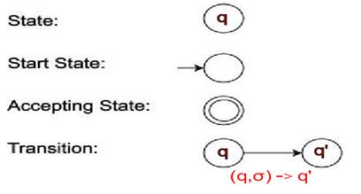
Pictorial Representation of DFA

Slide 19
FA diagrams
(single) start state
alphabet Σ = {0,1}
0,1
1
states
0
(several) accept states
transition for each symbol
0,1
read input one symbol at a time; follow arrows; accept if end in accept state

Slide 20
FA operation
Example of FA operation:
input:
0
1
0
1
0,1
1
not accepted
0
0,1

Slide 21
FA operation
Example of FA operation:
input:
1
0
1
0,1
1
accepted
0
What language does this FA recognize?
L = {x : x ∈ {0,1}*, x₁ = 1}
0,1

Slide 22
Example FA
0
1
0
even
odd
1
What language does this FA recognize?
L = {x : x ∈ {0,1}*, x has even # of 1s}
illustrates fundamental feature/limitation of FA:
“tiny” memory
in this example only “remembers” 1 bit of info.

Slide 23
A deterministic finite automaton (DFA)
is a quintuple M = (K, Σ, δ, s, F) where
K is a finite set of states;
Σ is an finite alphabet,
s ∈ K is the initial state,
F ⊆ K is the set of final states,
δ is the transition function from K x Σ → K
δ(p, a) = q

Slide 24
A language of an FA, M, L(M) is the set of Language words (strings) that accepts.
• If La = L(M), we say that M recognizes La .
• If La is recognized by some finite automaton FA , La is a Regular Language.

Slide 25
Q: How do you prove that a language La is regular?
A: By presenting an FA, M , satisfying
La = L(M).

Slide 26
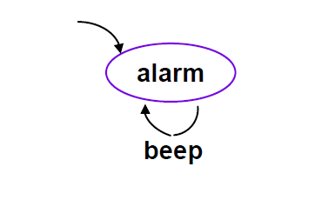
Simple Example
• States: {alarm}
• Actions: {beep}
• Initial state: {alarm}

Slide 27
Example
• States: {off, idle, moving, crashed}
• Actions: {key, gas, brake}
• Initial state: {off}

Slide 28
